Slide 1
Partner Technical Boot Camp
Secure Cloud Solutions

Slide 2
Secure Cloud Solutions

Slide 3

Abstract and Learning Objectives
In this whiteboard design session, you work with a group to design a solution for delivering modern application featureset using Secure Cloud best practices.
On completion of this whiteboard design session, your new awareness of Microsoft Security Best Practices will enhance your ability to design and deliver a secure cloud solution.

Slide 4
Step 1: Review the Customer Case Study
Outcome
Analyze the customer scenario.
Timeframe: 15 minutes

Slide 5


Customer Scenario
The Renewable energy industry is growing incredibly fast!
Contoso Solar, Inc. is a family-owned commercial and residential solar installation and wholesale supply firm, from the PNW, US
Established 2004, Contoso Solar have recently shifted their key operations to the cloud using Azure

Slide 6

Scenario Details
Contoso Solar Applications are managed by a lean DevOps team using Azure
They are expanding into a global market with new clients in Canada
As Industry grows, Contoso Solar’s main concern is providing secure B2B and B2C interactions with their core business applications and APIs

Slide 7
Scenario Details
B2B
B2C
OPS
Solar Manufacturer and Providers, including professional technical contributors such as: architectural, engineering, and regulatory from state and local entities
DIY Consumers purchasing components and services directly, or using extended offerings provided by Contoso Solar Consumer Services
Internal employee groups such as C-Suite, HR, IT, Fulfillment, Partner and Consumer Services, Sales and Marketing
Notes:
Given the environment, there are three valid authentication scenarios:
B2B - Partner Manufacturer/Suppliers should be able authenticate on invitation to Contoso's identity management using their work credentials via a guest configuration with Contoso's M365 tenant. This will allow partners to authenticate and be authorized to interact with Contoso's application platforms as required either through direct Web or API interaction or via M365 UX, or perhaps even via Azure AD Application Proxy for older apps supporting SAML only.
B2C - DIY Retail Consumers should be able to use the ecommerce purchase path to purchase solar components with an anonymous cart purchase path. Or they can create a persistent account with Contoso, using an email as username or using a social login from a valid Identity Provider, and save payment methods and view order status and order history along with sharing other social details if they desire. This method gives them access to pre- and post- sales technical support as well as event and blog content.
OPS - Existing and New internal employees should be able to login with their assigned Active Directory Work Account from any valid secure location on any approved device. Optionally this authentication flow may require multi-factor authorization (MFA). Once authenticated, the user will experience single sign-on (SSO) behavior across enterprise applications and endpoints until they fully log out.
Goal: Provide an enterprise-ready solution to unify user and service account authentication, authorization, and management (provisioning). This goal is essentially the foundational core of all the other requirements as it defines the identity management for users, LOB applications, and custom applications such as web apps, apis, service apps.

Slide 8


Primary Concerns
Contoso Solar is growing! Fast!
How does Contoso Solar provide for all the integration use cases and all the new growth in an efficient manner while also maintaining the highest vigilance for securing their distributed cloud systems?
Notes:
Contoso Solar is growing! Fast!
How does Contoso Solar provide for all the integration use cases and all the new growth in an efficient manner while also maintaining the highest vigilance for securing their distributed cloud systems?

Slide 9
Solution Requirements
B2B
B2C
OPS
Uniquely authenticate users in different workflows using one centralized identity platform
Ensure data and data access is protected at all times along the full stack, including database encryption, and application configuration
Ensure applications are secure and released in a secure, predictable manner
Notes:
Uniquely authenticate users in different workflows using one centralized identity platform
Ensure data and data access is protected at all times along the full stack, including database encryption, and application configuration
Ensure applications are secure and released in a secure, predictable manner

Slide 10
What is an Identity?
Account
Uniquely identify users within a common, simplified workflow
Map user account access to resources using defined policies
Apply changes to these mappings either by human or automated sponsorship
Identity
Resources
Policies
Notes:
Uniquely identify users within a common, simplified workflow
Map user account access to resources using defined policies
Apply changes to these mappings either by human or automated sponsorship

Slide 11
Solution Requirements
Register apps with the security solution so they can delegate on-behalf of valid user security scopes during authentication
Improve permissions management using roles and role memberhsip
Codify concept of Effective Permissions into any sponsored security workflow by checking roles
Application Permissions
User Permissions
+
=
User and App
Effective
Permissions
Notes:
Register apps with the security solution so they can delegate on-behalf of valid user security scopes during authentication
Improve permissions management using roles and role memberhsip
Codify concept of Effective Permissions into any sponsored security workflow by checking roles

Slide 12
Customer Questions
What is the appropriate platform we can use to consolidate security efforts into a more cohesive, preferably integrated singular authentication and authorization provider?
How can we automate account management workflow such as provisioning/deprovisioning, access control and audit?
As Contoso grows, system integration requirements will change, how can we manage change in terms of security?
What are the go-to design and platform options for our system integration application developers?
How does Microsoft Graph work with Microsoft Identity Platform and what is MSAL and what happening to Active Directory ADAL?
Notes:
What is the appropriate platform we can use to consolidate security efforts into a more cohesive, preferably integrated singular authentication and authorization provider?
How can we automate account management workflow such as provisioning/deprovisioning, access control and audit?
As Contoso grows, system integration requirements will change, how can we manage change in terms of security?
What are the go-to design and platform options for our system integration application developers?
How does Microsoft Graph work with Microsoft Identity Platform and what is MSAL and what happening to Active Directory ADAL?

Slide 13

Customer Objections
We are concerned that the addition of other AAD instances to support B2C and B2B guests will require us to recreate all of our accounts and reassign permissions
We are worried about applying RBAC because in the past it has been hard to ensure people get the right access
The Development Team is concerned that further constraining releases will slow down development
The Development Team is also worried about the depth of refactoring required to ensure custom apps can verify actions to roles
Notes:
We are concerned that the addition of other AAD instances to support B2C and B2B guests will require us to recreate all of our accounts and reassign permissions
We are worried about applying RBAC because in the past it has been hard to ensure people get the right access
The Development Team is concerned that further constraining releases will slow down development
The Development Team is also worried about the depth of refactoring required to ensure custom apps can verify actions to roles

Slide 14

Contoso Regional Premise Distribution
Contoso Solar Inc HQ is located in Seattle, WA.
This is where most of the business and operations team is located, including C-Suite, HR, Sales and Marketing, IT, and Development Teams Also in this building is one of 3 installation teams and kitting warehouses.
Seattle, WA
Contoso Solar Inc Portland, OR.
In this building is one of 3 installation kitting warehouses and small office space for the Portland, OR install team. There is one on-prem AD Domain Controller here and a small network, federated to the Seattle WA HQ.
Portland, OR
Contoso Solar Inc Austin, TX.
In this building is one of 3 installation kitting warehouses and small office space for the Austin, TX install team. There is one on-prem AD Domain Controller here and a small network, federated to the Seattle WA HQ.
Austin, TX

Slide 15

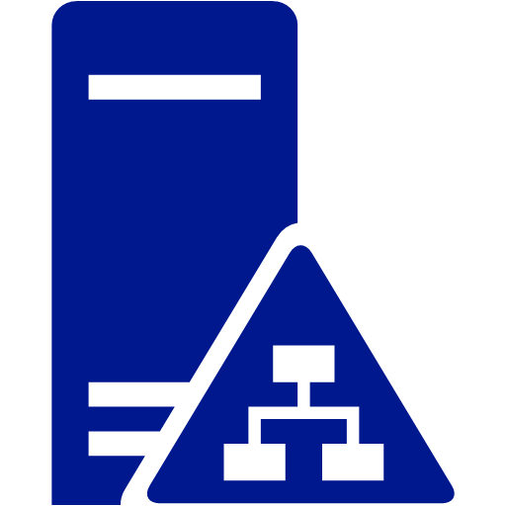


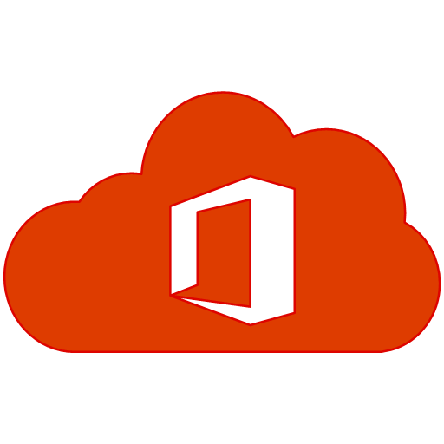






Current Contoso Security Architecture
On-prem Internal Ops
Azure
M365
Tenant
Azure Sub 1
Azure Sub 2
AD Sync
Stage and Production
Dev/Test
Austin, TX
Seattle, WA
Portland, OR
Ops, Reporting, and Analysis
Dev DB
External Partners (B2B)
Personalization
and Membership
Public DNS/IP
API
API
Customers (B2C)
Production
Stage
Dev/Test
Anonymous /
Personalization
and Membership

Slide 16
Step 2: Design the Solution
Outcome
In this whiteboard design session, you work with a group to design a solution for delivering modern application featureset using Secure Cloud best practices.
On completion of this whiteboard design session, your new awareness of Microsoft Security Best Practices will enhance your ability to design and deliver a secure cloud solution.
Timeframe: 60 minutes

Slide 17
Preferred Target Audience
The target audience consists of executive sponsors and the primary stakeholders in the field:
Susan Johnson (CEO)
Darren Cross (CFO)
Jessica Sams, CIO/DPO
Jason Ming VP of IT Operations
Dave Stone, Lead Development Engineer

Slide 18
Unified Identity Management

Slide 19
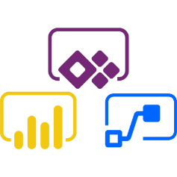


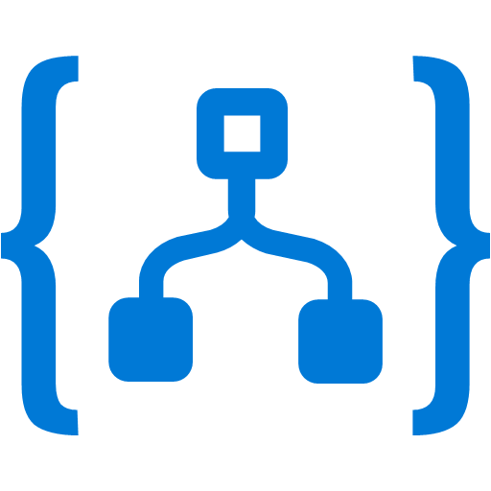


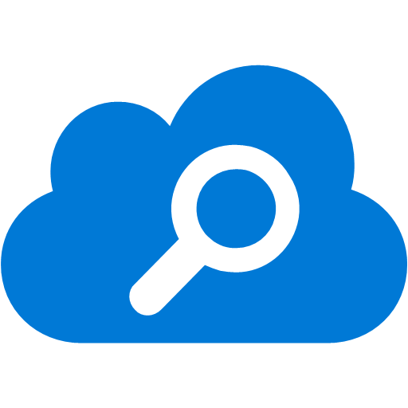



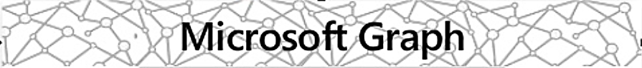











Unified Identity: Simple, Flexible, Secure Connectivity
Custom Integration
Azure / M365 Integration
Data
Connectors
Cloud
Analysis
Enterprise Mobility + Security Azure Cloud M365 Hybrid
Microsoft Identity Platform
Azure Integration
IDp Partners
Partner IdPs

Slide 20







Unified Identity: Simple, Flexible, Secure Connectivity
Browser
Web APP
Native or Mobile
Web API
Daemon or IoT
Web API

Slide 21
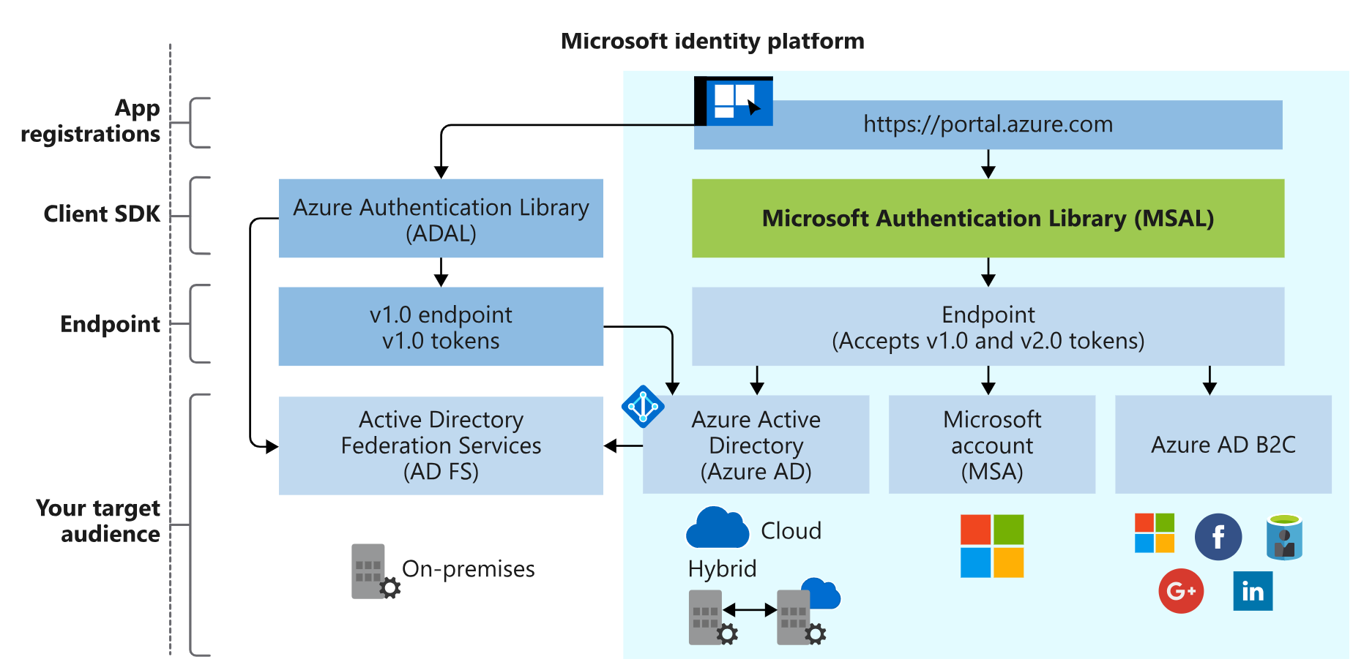
The Microsoft Identity Platform

Slide 22
Role-based Access Control

Slide 23
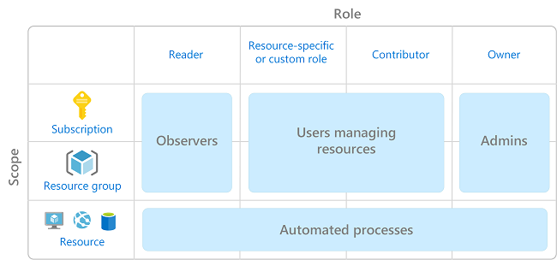
Role-Based Access Control
Create Access Permission Sets for Specific Roles and grant Permissions to Logins/Roles then add Users to Roles
Add Users to Fixed or Custom Roles using Rule of Least Privilege
Permission Sets and Roles are consistent with Azure Security Strategies.
RBAC allows fine-grained control for permission sets applied to Roles.
Notes:
We can see that Azure uses the same RBAC construct. So does M365. Now the solution just extends this paradigm into the enterprise with custom applications.
Create Access Permission Sets for Specific Roles and grant Permissions to Logins/Roles then add Users to Roles
Add Users to Fixed or Custom Roles using Rule of Least Privilege

Slide 24
Roles extend beyond the application workflow
Use role membership to group principals
Apply access permissions to roles (user and application roles)
Check roles within application workflows to secure data, resources, and actions
This gives operator security teams fine-grained access control based on role
Management of permissions is reduced because we are now managing roles, not individual accounts
Notes:
Roles extend beyond the application workflow into declarative management:
Use role membership to group principals
Apply access permissions to roles (user and application roles)
Check roles within application workflows to secure data, resources, and actions
This gives operator security teams fine-grained access control based on role
Management of permissions is reduced because we are now managing roles, not individual accounts

Slide 25
Use Roles to Inform Permissions
Register apps with the security solution so they can delegate on-behalf of valid user security scopes during authentication
Improve permissions management using roles and role memberhsip
Codify concept of Effective Permissions into any sponsored security workflow by checking roles
Application Permissions
User Permissions
+
=
User and App
Effective
Permissions
Notes:
Additive App and User Permissions Application Permissions for apps and users result in a union. Microsoft Identity Platform can deliver authorization based on this union.
Application Permissions for service of daemon apps use a slightly different flow for access tokens where they authenticate as “themselves”, not on behalf of the user by sending credentials. These applications use a Credential Flow in which each app has an individual credential with a unique username and password combination.
Applications that integrate with Microsoft Identity Platform follow an authorization model enabling administrators and users access control over how resources and data.
Application Permissions for apps and users result in a union. Microsoft Identity Platform can deliver authorization based on this union.
Application Permissions for service of daemon apps use a slightly different flow for access tokens where they authenticate as “themselves”, not on behalf of the user by sending credentials. These applications use a Credential Flow in which each app has an individual credential with a unique username and password combination.
Apps are allocated within Application Roles so once they authenticate with an api and get an access token the token contains roles not scopes as it would with a user. So it is the application role that is validated in the workflow versus scope for the user. Application permissions are created on the same MIP registration workflow used to register the application.
MIP supports two key types of permissions:
- delegated Permissions
- Application Permissions
**Delegated Permissions**
This permission type is utilized by apps that have a signed-in user present. In this permission context, either the user consents to grant the requested permissions to the app, thus the app is "delegated permission to act" as the signed-in user when accessing resources and data.
**Application Permissions**
This permission type is utilized by apps that run without a signed-in user present, such as background services or daemons.
In this permisison context, permissions can only be granted by an administrator.
By defining permission types, operator teams now have fine-grained access control API workflow and data.
This means any integrated app can request permissions to execute workflow or access data. Using this construct, apps can request only the specific permissions required to execute their function. Nothing more, nothing less.
Further, the code becomes more declarative, as developers can literally read what permissions are being requested and checked within the actual code line.
On the management side, administrators can know exactly what access the application is intended to have based on what is seen in app registration.

Slide 26
Management with Role Separation
Role Separation ensures risk is controlled by spreading responsibilities across roles ensuring no one role has complete access to the entire key and data space.
Unauthorized users have no access to data or encryption keys*
Keys can be managed without Role Separation but internal access risks may develop
*Cloud Application Administration or Subscription Owner with full Admin rights role technically has access to all data within an specified subscription. Use of custom or specific roles mitigates this!
Notes:
To promote security, Operator Teams can create a separation of roles within the team. The separation creates a distinction between those who OWN the data (and can view it)… … and those who MANAGE the data (but should have no access).
Using suggested role separation within the Operator Team, there are at least two distinct roles who manage Always Encrypted keys: Security Administrators and Database Administrators
Security Administrator - This role creates Column Encryption Keys (CEK) generates column encryption keys and column master keys and manages key stores containing the column master keys. To perform these tasks, a Security Administrator needs to be able to access the keys and the key store, but does NOT need access to the database.
Database Administrator - manages metadata about the keys in the database. To manage keys metadata this role needs permssions to view and manipulate key metadata in the database. However this role does NOT have access to the keys or the key store holding one or more Column Master Keys (CMKs).
The general recommendation is that organizations should opt for role separation in this manner whenever possible. However, smaller organizations may not create this separation in an effort to reduce complexit.
When Always Encrypted keys are managed without role separation, a single person can assume both Security Administrator and DBA roles, which implies that person needs to be able to access and manage both the keys/key stores and the key metadata. Moving to a DevOps model, organizations can more efficiently manage AE keys without role separation as the DevOps process can be secured and monitored separately from discrete “one-off” configuration operations.
The primary driver here is if the database is cloud-based and Operator Teams want to restrict cloud administrators (but not database manager types) from data access.

Slide 27
Common Identity Platform Authentication Flows for Contoso

Slide 28

A Simple Application Authentication Flow
Authentication Flows are consistent and secure with Identity Platform!
Represent custom workflows that reflect business needs as well as reducing complexity and user experience issues (SSO, scope prompting)
Enable direct API integration to represent a comprehensive, event-driven workflow across applications.
ASP.NET Core Web App
1
https://<site>.com
2
Redirect
3
Credential prompt
Microsoft Identity Platform
4
Access Token + redirect URL
5
Access Token
Notes:
Authentication Flows are consistent and secure with Identity Platform!
Represent custom workflows that reflect business needs as well as reducing complexity and user experience issues (SSO, scope prompting)
Enable direct API integration to represent a comprehensive, event-driven workflow across applications.

Slide 29

“On Behalf Of” (OBO) Authentication Flow
https://<site>.com
Microsoft Identity Platform
Post authentication, with a web api, that web api can log into yet another web api on behalf of the user without the user even knowing it.
Web APP
Web API
Web API
1
User is authenticated, application sends access token A to Web API A
Request access token for Web API B providing token A, client ID and secret
2
Call Web API B with access token B in authorization header
3
Request Access Token B
4
5
Return data from secured source
Notes:
Most authentication scenarios acquire tokens on behalf of signed-in users.

Slide 30
Securing Data in Motion and at Rest

Slide 31


What is Row Level Security (RLS)?
Control data access and simplify security design:
Fine grained, row-level access control over a table
Enables multiple user security classifications in a single table (read: multi-tenant)
Support for transparent filtering and blocking rules based on query execution context rather than user access permissions
Enforcement logic is schema bound to the table, inside the database
Notes:
With Row-Level Security (RLS) we can control data access and simplify security design by:
Applying a fine-grained grained, row-level access control over a table based on user security context.
This enables multiple user security classifications in a single table (read: multi-tenant) and support for for transparent filtering and blocking rules based on query execution context rather than user access permissions directly because, the security filtering logic is schema bound to the table object

Slide 32

Implementing Row Level Security
Security Admin Role
CREATE FUNCTION dbo.fn_securitypredicate(@region int)
RETURNS TABLE WITH SCHEMABINDING AS
return SELECT 1 as [fn_securitypredicate_result] FROM
SalesRegion sr INNER JOIN Employees e
ON (sr.EmpId = e.EmpId)
WHERE e.UserSID = SUSER_SID() AND @region = sr.region;
CREATE SECURITY POLICY dbo.SecPol
ADD FILTER PREDICATE dbo.fn_securitypredicate(region) ON Customers WITH (STATE = ON)
Customer.Name | Customer.SSN | Customer.Email
Michael Schumacher | 123-45-6789 | schumy@hotmail.com
Ayrton Senna | 444-55-6666 | senna@gmail.com
Jim Clark | 000-99-1234 | jclark@aol.com
Authorized User
SELECT * FROM Customers
SELECT * FROM Customers SEMIJOIN APPLY dbo.fn_securitypredicate(Customers.region);
SELECT Customers.* FROM Customers, SalesRegion sr INNER JOIN Employees e ON (sr.EmpId = e.EmpId) WHERE e.UserSID = SUSER_SID() AND Customers.region = sr.region;
Notes:
As with earlier examples, we start with a database…<click>
And you remember this table data from before…<click>
A member of the Security Admin Role or other suitable role implements a row function and assigns a security policy to the table which associates that row function to the table. The row function is used on selects moving forward, and as you can see, the function filters rows based on the User SID and the Sales Region associated with the User.<click>
After this configuration, when users select from this table, the result set is filtered on the Sales Region associated with the User.
The advantage here is: Security is declarative, easy to understand and is now essentially part of the actual schema that defines the table. RLS works with both Azure Active Directory and SQL Authentication.

Slide 33
Data Encryption - Overview
Transparent Data Encryption
Always Encrypted
Separation of Roles
Physical Storage-level key-based encryption for data at rest
Key is stored in database boot record based on a server managed certificate
Client-based encryption for data at rest and in flight
Encryption keys are never revealed to database processes
Role separation provides fine grain data access control
Improves security management process
Notes:
Shifting gears, Let’s take a look at Data Encryption Options in Azure SQL Database.
Looking from LEFT to RIGHT here, we introduce two different types of built-in data encryption (TDE and AE)… And that third box on the RIGHT, is a necessary companion concept: Separation of Roles.
Starting left we have Transparent Data Encryption (encrypting Data at Rest) providing Storage-level encryption
Moving to the center, Always Encrypted (encrypting Data at Rest and Data in Motion) providing client-managed end to end encryption through the use of software libraries
Finally, Separation of Roles establishes a brief but effective strategy to manage data security and access by creating roles with specific access and then applying users to these roles. So, think in terms of Roles: Data Security Administrator vs. A Data Administrator Vs. A standard Application User

Slide 34



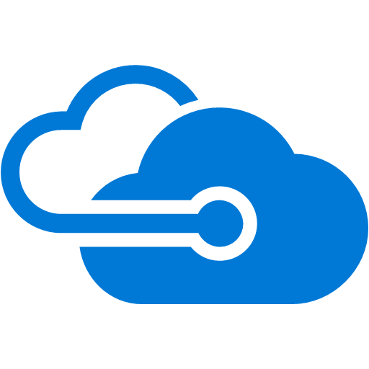



Two TDE Key Management Strategies
Service-Managed…
Customer-Managed…
DEK created using unique built-in certificate at
Logical Server Level
Key Created in Azure Key Vault or on HSM Device and stored in Vault
Logical
Server
Azure
Key Vault
Azure Manages Certificates
Certificate
TDE
Protector
Key
HSM
DEK
DEK
DEK is stored in DB Boot Page
DEK is stored in DB Boot Page
Notes:
TDE has two basic management strategies:
Service-managed transparent data encryption
Customer-managed transparent data encryption or BYOK
Service-Managed TDE
Azure provides ease of deployment as TDE is enabled by default for newly created Databases instances. By default, TDE uses Service-managed transparent data encryption which means the AES256 database encryption key used to encrypt data is managed and protected by a built-in server certificate. This certificate is unique to every instance.
It is important to call out that these certificates are fully managed by Microsoft, and therefore, certificate rotation is managed by Azure in compliance with a standing internal security policy and the root key is protected by a Microsoft internal secret store.
An additional note: If a database is configured for geo-replication then both primary and secondary databases are protected by the primary database parent server certificate. In addition, databases connected to the same logical server share the same built-in certificate. The Service-Managed scenario on the left shows this last scenario with two databases connected to the same logical server.
Customer-Managed TDE Azure SQL Database also supports Transparent Data Encryption using BYOK or Bring-Your-Own-Key. This is the Customer-managed transparent data encryption scenario.
In this scenario, the customer is responsible for providing the encryption key using a customer-managed Azure Key Vault instance associated with the subscription. The key an be generated within that Azure Key Vault instance, or generated by an individual HSM device and imported into the Azure Key Vault. This key is a service-based asymmetric key, called a TDE Protector and this key is used to encrypt/decrypt the TDE Database Encryption Key (DEK) stored on the boot page of the target database. The DEK is the key used to encrypt the data at the volume level.
For this scenario, the TDE Protector is scoped at the logical server level and therefore is inherited by all databases instances associated with that server.
NOTE The TDE Protector resides in Azure Key Vault only. The Azure SQL Database is granted service access to Azure Key Vault in order to reference the TDE Protector when needed for encryption.

Slide 35
TDE Management Implications
Intrinsic query performance impact (2-4%) so challenges CPU bound instances
Depending on Management Scenario: Restoring to another database requires certificate and key import process
At any moment there can be ONLY ONE TDE protector set for a given logical server
Azure Key Vaults can be configured in multiple regions to support HA requirements
Course-grained Encryption that ONLY Encrypts Data at Rest, Data In-flight unprotected
Notes:
There are a few things to consider with TDE:
Intrinsic query performance impact is around 2-4% so there may be performance knock-on effects on CPU-bound instances
For database operations: Using the Service-Managed Scenario, operator teams are not required to decrypt databases for most database operations such as restore, copy, or backup to another configuration like Managed Instance. Azure manages TDE configuration and expresses this configuration on the target instance. For Geo-Replication, the transparent data encryption settings on the Primary are transparently inherited on any Secondaries.
For the Customer-Managed Scenario, things are a bit more involved: Once encrypted, any generated backups are also encrypted with the same TDE protector. A key point: If the TDE protector is changed, the existing backups are not updated to use the new TDE protector. So restore a backup encrypted with a previous TDE protector from Key Vault, operator teams will need to archive older TDE Protectors in the Key Vault to make them available to the target server.
And once again let’s remember, TDE is designed as a course-grained Encryption that Only Encrypts Data at Rest, Data In-flight, data is unprotected!!

Slide 36
Data Encryption – Always Encrypted
Data and Applications
Management
Performance
Client-side Encryption with data encrypted in flight and at rest
Integrates seamlessly with performance oriented .NET APIs
End-to-End, easy to configure column-level encryption
BYOK and key-set rotation using Azure Key Vault or Azure Certificate Store
Low performance and overhead with slight CPU Hit
Support for accepted and secure external key store methods
Notes:
Now let’s take a look at Always Encrypted (AE)
Always Encrypted allows clients to encrypt sensitive data inside client applications using a pre-defined set of encryption keys by using a .NET library. The data is encrypted at the database column level and remains encrypted until decrypted by another process using the same key set.
Through the use of specific .NET client APIs, applications can query the encrypted data space, using a technique that never reveals the encryption keys to the Database Engine.
The goal is to create a separation between the stored encrypted data and the metadata that encrypted it through a functional bridge – in this case, the .NET client APIs.
As a result, using Always Encrypted we get:
Fine-grained, column-level encryption based on connection context
Support for key-set management including full encryption, protection of the encryption key, key rotation where a column encryption key can have up to two different encrypted values, each encrypted with a different column master key value that can be rotated on a scheduled basis
Key sets generated outside of the database execution domain
Full support for BYOK scenarios with secure storage capability using a number of different accepted secure methods NOTE Key sets must be archived in a key cycle to support various backup, copy, and recovery operations.
For more information check out the URL below.

Slide 37
Always Encrypted – Required Key Sets
Column Encryption Key (CEK)
Column Master Key (CMK)
Cryptographic Key to encrypt column
A single CEK can encrypt or decrypt column values via use of .NET SQL Data CEK metatdata found in: sys.column_encryption_keys,
Sys.column_encryption_values
Cryptographic Key protecting the CEK Stored externally in a secure key vault (Azure Key Vault, Cert. Store, HSM) Database metadata only contains data about key store type and location in: sys.column_master_keys
Notes:
Always Encrypted uses two distinct types of ypes of cryptographic keys to form a key-set.
Basically: The Column Encryption Key (CEK) encrypts the data in a specified column and the Column Master Key (CMK) encrypts the Column Encryption Key. This two-step process is functionally what separates the actual cryptographic keys, and the metadata objects that defines the keys and it is this very separation between the actual keys and their definition that creates the secure configuration.
From how the encrypted query process works to team role separation, no one agent has access to all facets of this encryption paradigm, and thein lies its strength.
The Column Encryption Key (CEK)
This is the key used to encrypt the data in the configured column. Note that the CEK definition is stored within database metadata and a single CEK can encrypt all values for the range of a particular configured column.
Use catalog views to view information about column encryption keys: sys.columns (Transact-SQL), sys.column_encryption_keys (Transact-SQL), sys.column_encryption_key_values (Transact-SQL)
Column Master Key (CMK ) or the Key-protecting Key This key is used to encrypt the CEK. CMKs must be stored in a trusted key store, such as Azure Key Vault, Microsoft Isolated Certificate store, or a hardware security module. It is important to remember that properly configured, the database does not ever see this key in plaintext. The database metadata only contains data about key store type and location, and this information can be found in sys.column_master_keys catalog view

Slide 38


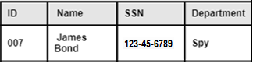
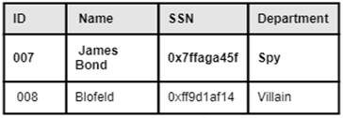
Always Encrypted – Client-Side Management
1
Application
2
Azure SQL Database
Data Provider for SQL Server >.NET 4.6
Column Master
Key (CMK)
SELECT Name FROM Employees WHERE SSN = @SSN @SSN =‘123-45-6789’
SELECT Name FROM Employees WHERE SSN = @SSN @SSN =‘0x7ffaba45f’
Query
Encrypted Query
4
Query after encryption
5
Key Metadata
CMK and CEK Meta (Location)
Decrypted Result Set
Column Encryption
Key
(CEK)
3
Azure Key Vault or BYOK
Column Master
Key (CMK)
Column Encryption
Key
(CEK)
Column Encryption
Key
(CEK)
Used to encrypt
Notes:
Always Encrypted requires some planning and some modification to both data model (at the schema level) and some application level changes to configure the application to use the appropriate APIs.
Let’s take a moment and cover this rather busy diagram. On the left in green is the application domain. On the right, in grey, an Azure SQL Database Instance domain.
Working from left to right:
The client application invokes a query (either directly or through Entity Framework or other suitable Object-Relational Model API). The query is sent through a valid SQL Connection via the client-side driver – in this case, SQL Server Data Provider .NET 4.6 or greater.
1) Using this driver requires a parameterized connection and also requires certain schema changes on the database in order to support column-level data encryption.
Note again the database never stores the keys, only the metadata – e.g. the encrypted values for the CEK, and the location of the CMK The driver is responsible for coordinating with the database to discover which columns have encryption applied and will gather the algorithm and encrypted value of the CEK applied to each encrypted column along with the location of the associated CMK which is then cached locally. The following happens at the application level:
2) For parameterized queries, the driver coordinates with the database to determine which parameters use encrypted columns and should be themselves encrypted. The driver gets encrypted value of the column encryption key, and the location of its corresponding CMK location information which is subsequently cached for performance.
3) Next, the driver interacts with the key store specified by the CMK location information and uses the CMK to decrypt the encrypted CEK value and this value is also cached locally. Here it gets interesting:
4) On outgoing queries (that is, queries sent to the database) the driver will use the CEK value to encrypt protected parameters. This means the database gets the encrypted values for protected parameters that cover encrypted columns. This is data that is protected in flight – outgoing. 5) On incoming result sets from the database for any encrypted columns, the driver appends encryption metadata for the column - the algorithm and the key. Then the driver first taps the local cache to find the corresponding CEK and uses this value to decrypts the results on the fly, returning plaintext values in their proper order in the resultset to the invoking application.
And here we come to the overall result: The driver is encapsulated and invoked by the application domain and thus all encryption/decryption occurs WITHIN the driver and domain – not the database. The driver negotiates with both the database AND the Key Store to get the necessary algorithm and key values to encrypt and decrypt on the fly in both directions thus eliminating any possibility of unecrypted data interception via transmission to and from the database instance.
This process ensures data remains encrypted AND queryable at all times – complete protection at rest and in flight.

Slide 39
Always Encrypted – Encryption Types
Deterministic Encryption
Randomized Encryption
Generated encryption output is the same result for a given input - good candidate for query predicate equality
Can be indexed
Higher entropy risk for small value sets (boolean, categorical, numeric)
Random encryption output generated for a given input - good candidate for data returned as aggregate in a set
Cannot be indexed
Truly random values
Lower entropy risk for small value sets (boolean, categorical, numeric)
Notes:
Always Encrypted provides support for two types of column encryption: Deterministic and Random
Encryption Options
Using Deterministic Encryption, column encryption values generated is the same result for a given input, so across the column range, equality comparison can be used in queries. Other operations such as greater than, less than, pattern matching using the LIKE operator, etc are not supported, however
Columns using Deterministic Encryption can be indexed but require collations with binary2 sort order (BIN2 Collations)
Using Randomized Encryption results in a truly random generated value for a given input so equality comparison doesn’t work. Further, this type of encryption results cannot be indexed.

Slide 40
Always Encrypted – Management Implications
Keys used in the database are backed up in database metadata
A separation of roles increases the security depth for a given data corpus.
The Key generation process for Column Master Key (CMK) and Column Encryption Key (CEK) becomes an enterprise policy concern
Performance impacts are measurable and are commensurate with number of encrypted colums, column type, and field length
Database operations such as copy, restore, and backups are dependent on key sets so a key archival process must be managed
Notes:
Always Encrypted allows clients to encrypt sensitive data inside client applications and never reveal the encryption keys to the Azure SQL Database.
Consider the following threats:
Internal – malicious role-based employee with elevated permissions
External* – data center user with elevated permissions scanning host processes or SQL Server specific processes, potentially viewing resultsets across the wire.
* With Azure SQL Database external threats become less likely, but still a regulated concern as a matter of best practice
Always Encrypted is effective in preventing these types of attacks because the encryption process protects:
Data is encrypted in flight and at rest, denying external scanning threats
Keys are never sent across the wire also denying external scanning threats.
So, To review:
The concept of Role Separation is supported here, differentiating from management types: Security Administrator vs DB Administrator Built-In accounts. Unauthorized users never have access to data or keys (including high privilege users such as administrators)*. * NOTE Cloud Administrators do have access to both the data and the keys, however: the customer still benefits from reducing the security attack surface area as the data is always encrypted in the database.
The end-result of query is controlled by application logic as Role-based permissions do not determine whether data is encrypted or decrypted on delivery of query result sets. There are other constructs within Azure SQL Database to control this aspect.
The certificate and symmetric key are backed up automatically in the database metadata but restores to another server require new key rebuild step. So for instance, a Restore to a new instance requires new key generation process for keys in order to configure the restored copy of the data to the appropriate key. This is relatively easy to do using Azure Key Vault by archiving key sets.
Query Performance Impact is based on number of encrypted columns and data type and length so there is a measured Intrinsic query performance impact that increases per column

Slide 41
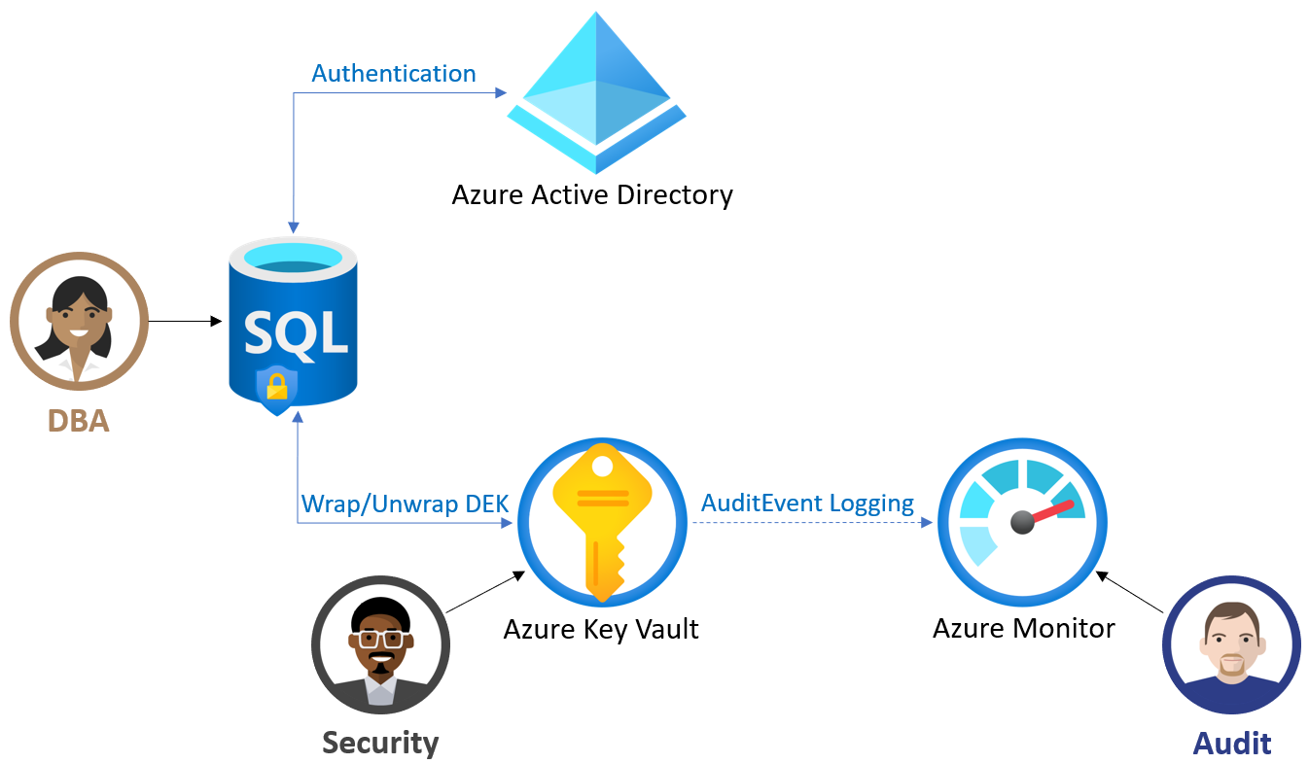
Self-Managed or BYOK Scenarios
Contoso’s main M365 tenant provides role resolution
For Contoso, BYOK scenario works for both TDE and AE
Effective Security Policy requires a separation of roles when managing keys.
For Contoso, Azure SQL DB has direct integration with Azure Key Vault via App Registration with MIP – using a managed identity

Slide 42
Using Azure Key Vault to Secure Application Configuration

Slide 43
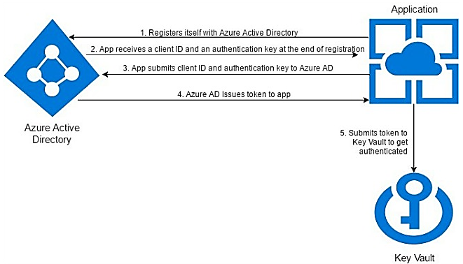
Custom Application to Azure Key Vault Integration
Contoso apps are registered with AAD to use managed identities to access AKV
Contoso places an AKV in key environments
Notes:
Part of Contoso's requirements is to encapsulate sensitive configuration data away from application configuration. AKV meets the requirement for FIPS 140-2 Level 2 validated Hardware Security Modules (HSM's) when storing configuration data so it is exceptionally secure and is a right fit for Contoso's needs.
Applications can use the Microsoft Azure Key Vault Configuration Provider to load app secrets as configuration values during startup.
The configuration Provider is in this package: Microsoft.Extensions.Configuration.AzureKeyVault
Contoso development teams can use this method for controlling access to sensitive configuration data.

Slide 44
Ensuring Secure Application Configuration and Deployment

Slide 45
Robust Deployment using a Deployment Tool-Chain
Secure applications are deployed on a declarative and repeatable deployment pipeline that deploys to verified environments with their own lifecycle process.
Apps are developed from an official repo configured to this pipeline and this is the only source for secure app deployment through ALL STAGES of the SDLC. “One-click”, or “drag and drop” deployments are NOT allowed in any stage of development once an application leaves POC or local development status.
Contoso official releases, use a consistent cadence, and involve a release pattern using trunk-based deployment into a dedicated blue-green production environment that meets security requirements.
All code changes for applications (major and minor releases, scheduled patches, and hotfixes) are all released using this process.
The ultimate goal here is to provide a formal, secure, and repeatable process with conditional visibility to prevent injection of accidental vulnerabilities as well as reducing opportunities for malicious releases.
Notes:
A Robust Deployment Tool-Chain
For Contoso, secure applications are deployed using a verified declarative and repeatable deployment pipeline via Azure DevOps.
Any approved application is developed from an official repo that is configured to a declared build pipeline and deployed using that same pipeline to approved environments. Deployments use a declared cadence with the exception of hotfixes which are few and far between.
This is the only source for secure app deployment through ALL STAGES of the SDLC. “One-click”, or “drag and drop” deployments are NOT allowed in any stage of development once an application leaves POC or local development status.
The release process for Contoso, involves a pipeline executed release pattern using trunk-based deployment into a declared blue-green production environment.
All code changes for applications including major and minor releases, scheduled patches, and hotfixes are all released using this process.
The ultimate goal here is to provide a formal, secure, and repeatable process with conditional visibility to prevent injection of accidental vulnerabilities as well as reducing opportunities for malicious releases.

Slide 46
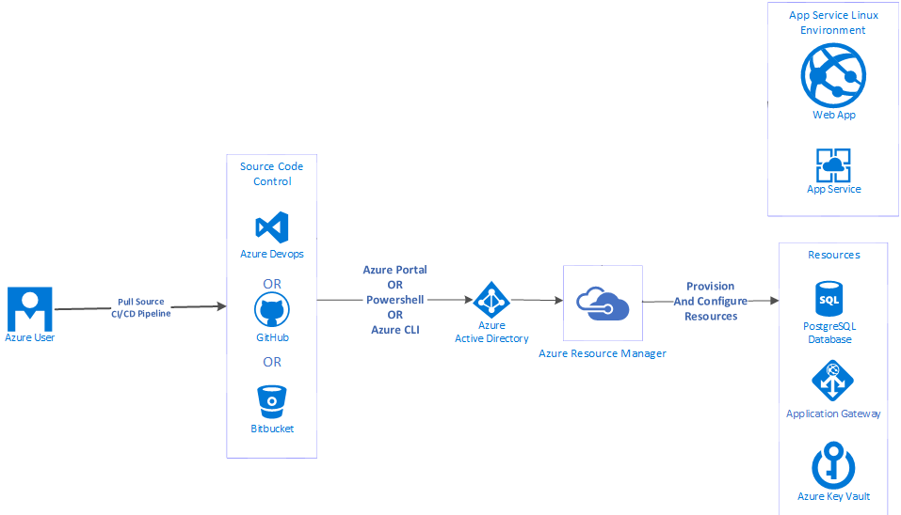
Secure Application Deployment
Notes:
Secure applications are deployed using a verified declarative and repeatable deployment pipeline via Azure DevOps. This is the only source for secure app deployment through ALL STAGES of the SDLC.
“One-Click”, or “drag and drop” desktop deployments are not allowed in any stage of development once an application leaves
POC or local development status. Any approved application is developed from an official repo that is configured to a declared build pipeline and deployedusing that same pipeline to approved environments.

Slide 47
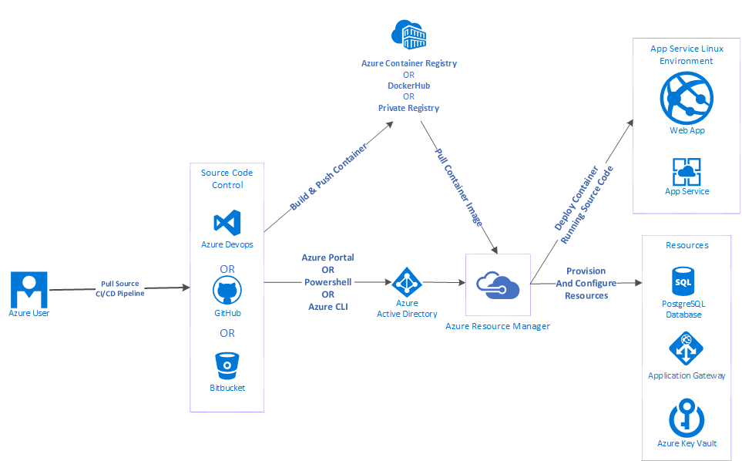
Secure Container Deployment
Notes:
This same concept works for container apps as well as direct app deployment.
For container apps you have added container management tooling and tasks integrated directly within the pipeline job definitions.

Slide 48
Step 3: Present the Solution
Outcome
Present a solution to the target customer in a 15 minute chalk-talk fomat.
Timeframe: 30 minutes
(15 minutes for each team to present and receive feedback)
Directions
Pair with another table.
One table is the Microsoft team and the other table is the customer.
The Microsoft team presents their proposed solution to the customer.
The customer asks one of the objections from the list of objections in the case study.
The Microsoft team responds to the objection.
The customer team gives feedback to the Microsoft team.

Slide 49
Customer Quote
"Securing our Cloud Applications is a key initiative for this fiscal year, as our compliance levels and growth position us to take on our first international client as well as ensuring the proper security stance on custom applications and partner integrations for our existing domestic operations.
Using Azure and the Microsoft Identity Platform allows us to extend our identity and access management far beyond our existing security strategy, facilitating support for the varied identity access types for our business partners and customers."
~Jessica Sams, Chief Information Officer and Data Protection Officer Contoso Solar, Inc.

Slide 50
Wrap-Up
Outcome
Identify the preferred solution for the case study.
Identify solutions designed by the other teams.
Timeframe: 15 minutes

Slide 51
Thank you.

